Slide 1
Modeling Process
Anderson and Woessner (1992)

Slide 2
Calibration
What are you calibrating to?
Data – accuracy of data?
Conceptual model
Hydrologic vs geologic evidence
Uniqueness
Wet vs dry model
What is considered “good”?
Mean error and mean absolute error
Error distribution
When to stop?
How to proceed:
Automated parameter estimation (PEST module)
Minimize an objective function
Better for simple models
Too many degrees of freedom
Too many calibration targets
Changing geology and conceptual model
Collection of additional field data

Slide 3
Non-uniqueness of models that only calibrate to head measurements
Recharge
Land surface
Water table
Flow
Well 1
Well 2
Well 3
Combinations of K and R that produce a good head match
Recharge - R
Increasing flow
Hydraulic Conductivity - K

Slide 4
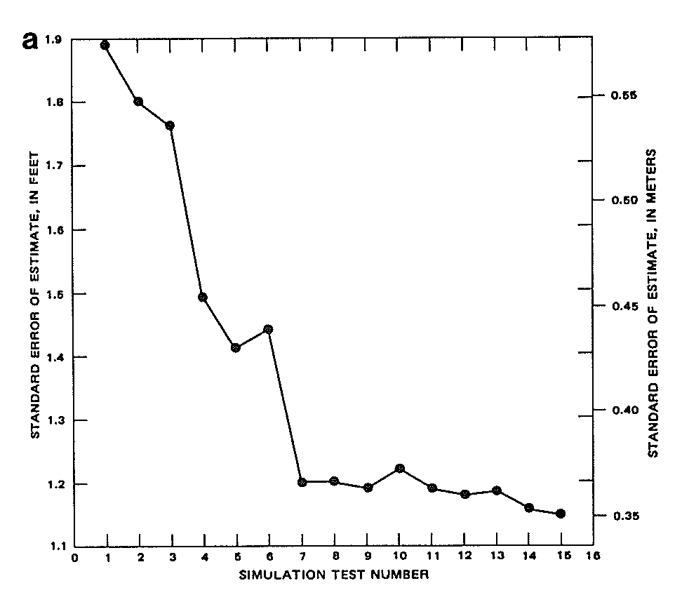
Calibration – Reduction of errors compared to measured values
Yager (1986)

Slide 5
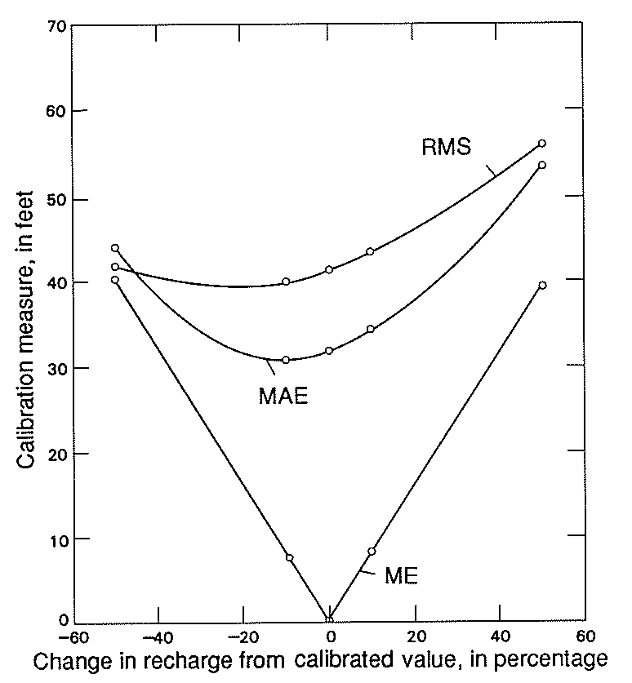
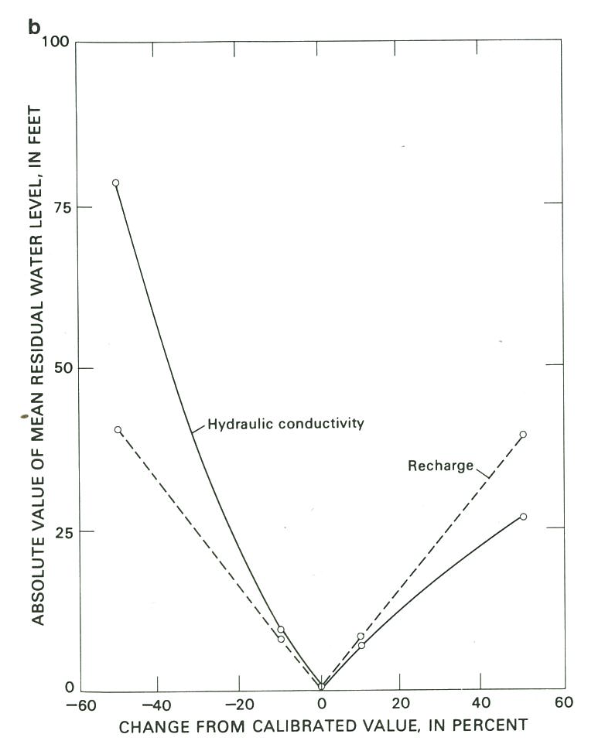
Calibration – Reduction of errors compared to measured values
Luckey et al (1986)

Slide 6
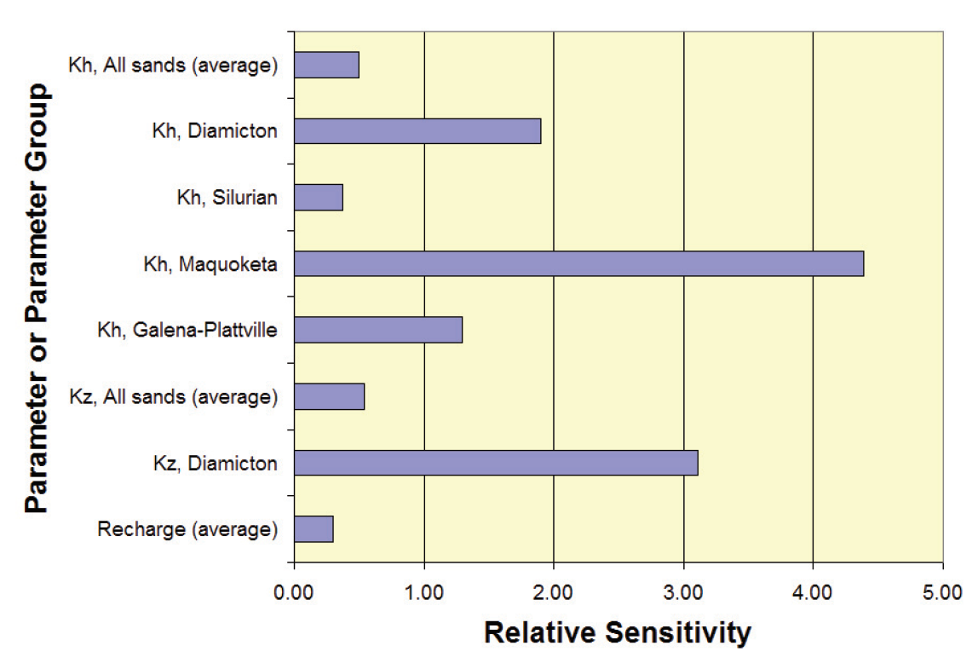
Calibration – Parameter Sensitivity
Kane County Model

Slide 7
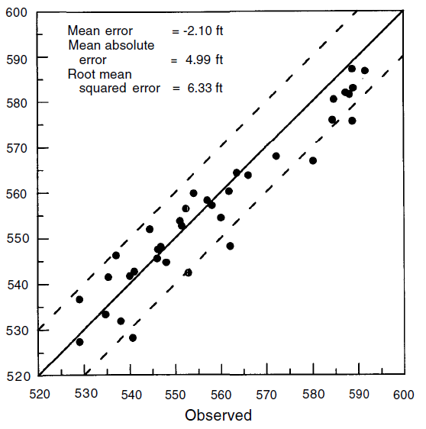
Calibration – Calculated vs observed water levels
Wilson et al (1998)

Slide 8
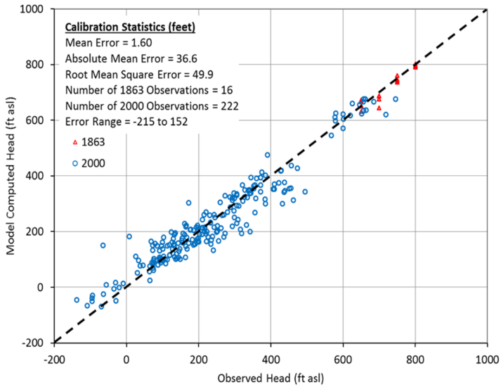
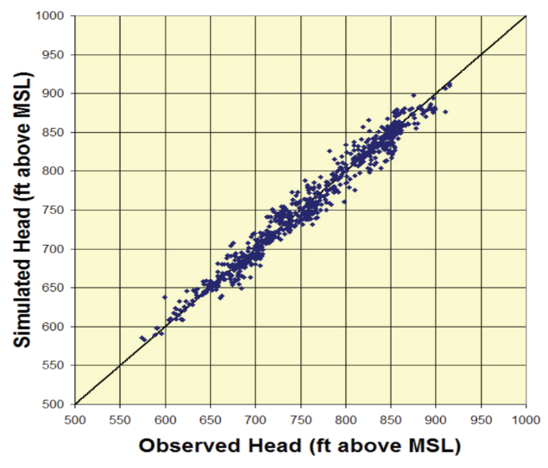
Model Calibration
Comparison of model values versus measured water levels
NE Illinois Bedrock
Kane County
Mahomet Aquifer

Slide 9
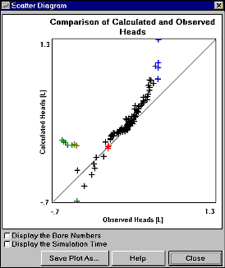
Calibration – Trending Error
PWN4XT

Slide 10
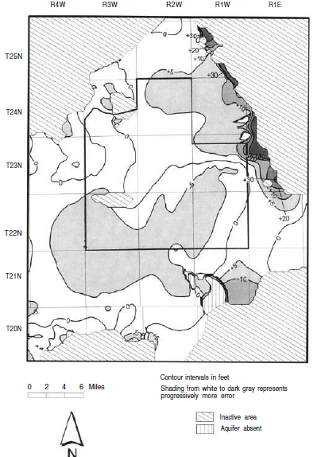
Calibration – Distribution of Error
Wilson et al (1998)

Slide 11
Model Calibration
Comparison of model values versus stream flows – Kane County Model

Slide 12
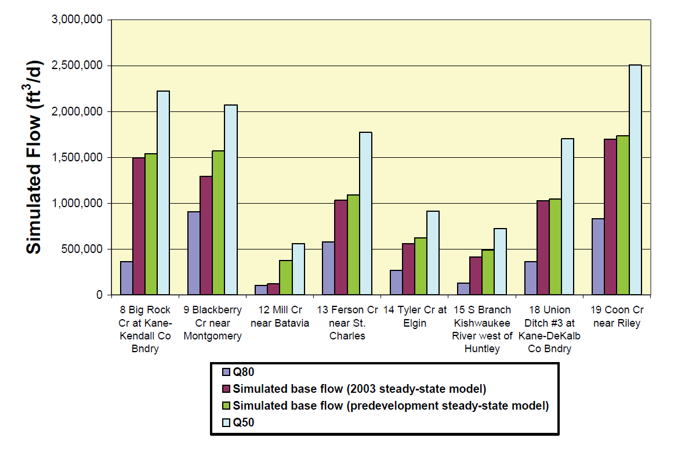
Model Calibration
Comparison of model values versus stream flows – Kane County Model

Slide 13
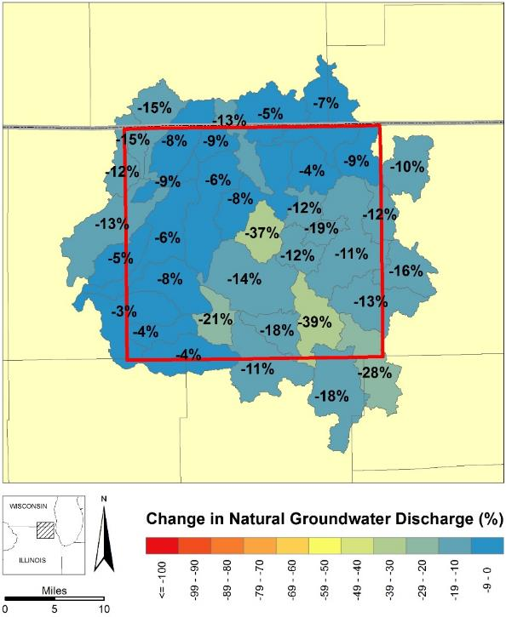
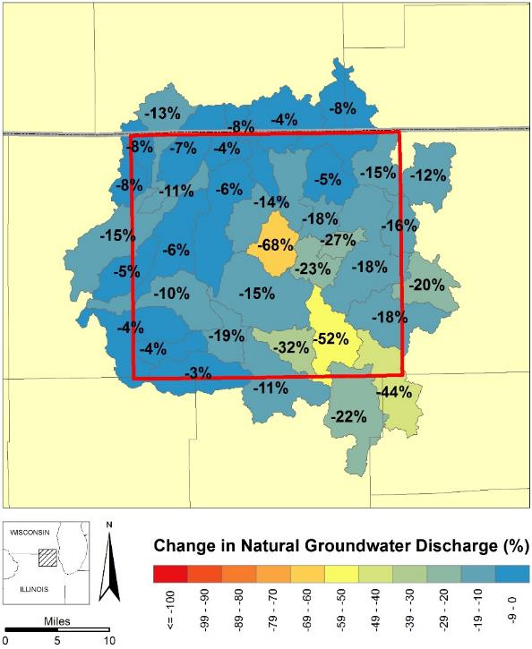
Simulated Change in Natural Groundwater Discharge
2009
2009
2050
Scenario)
-10.5%
-14.8%

Slide 14
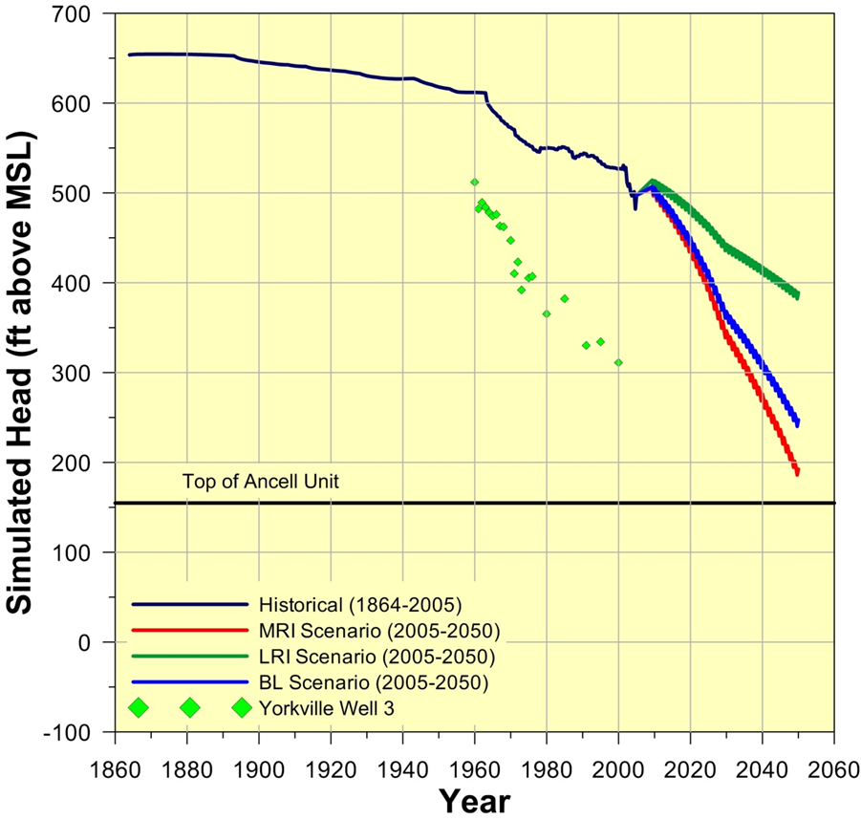
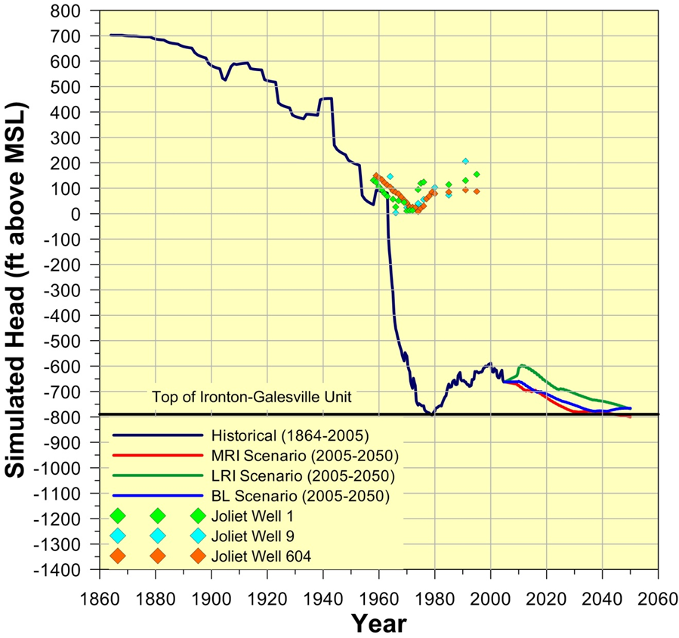
Calibration – Old NE Illinois Model

Slide 15
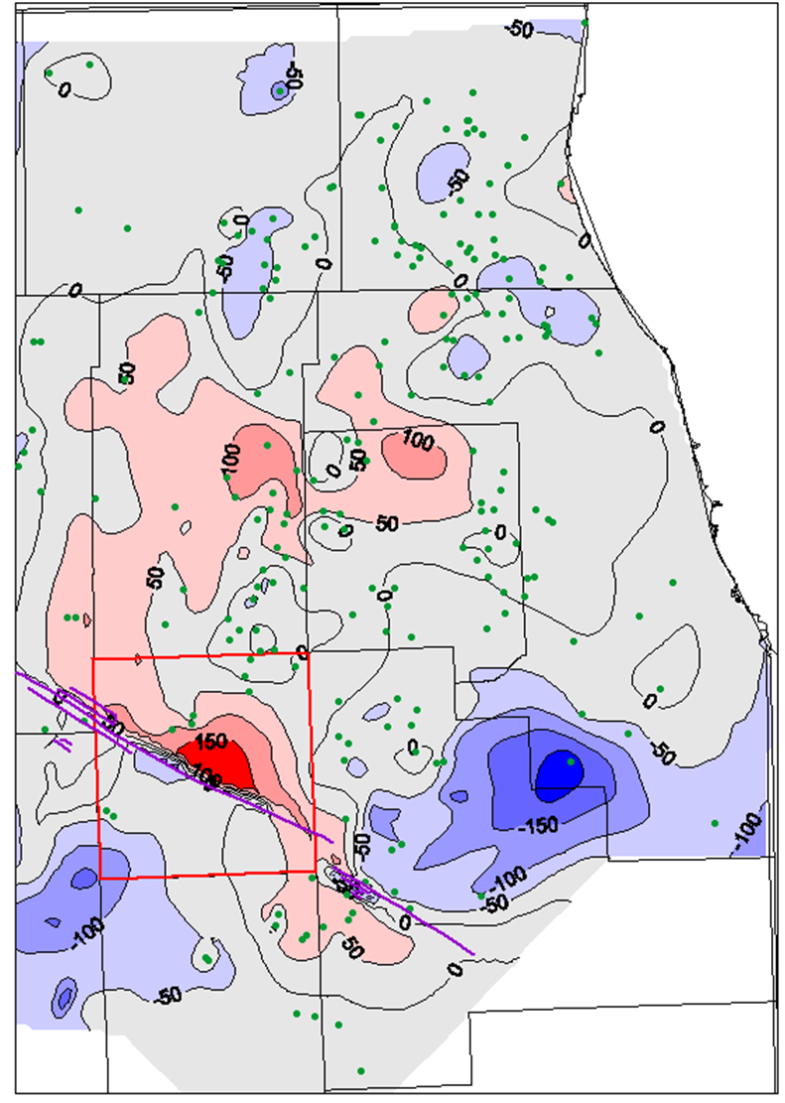
Distribution of Error -2013 NE Illinois Model

Slide 16
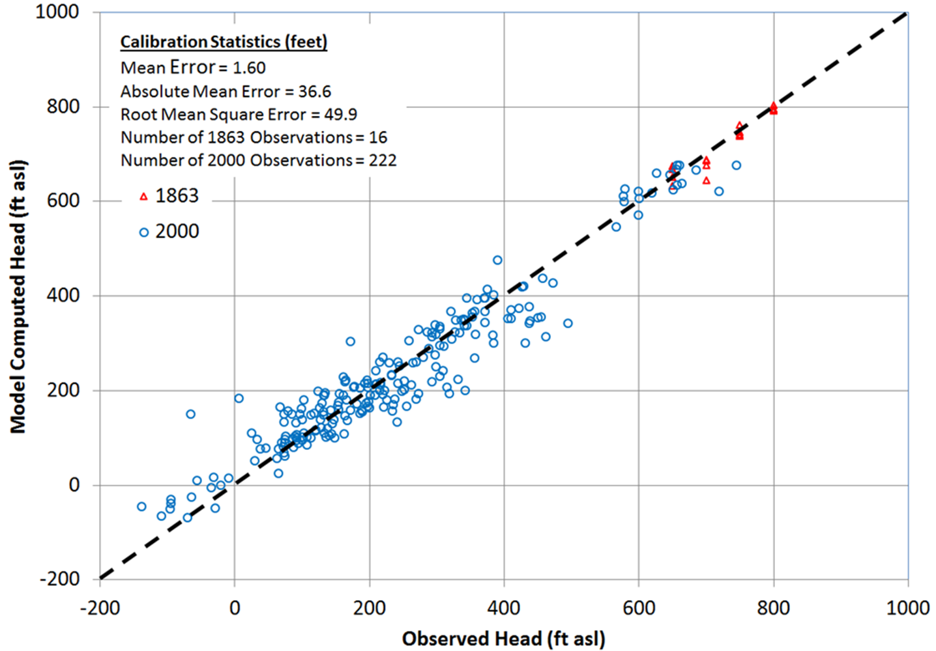

Slide 17
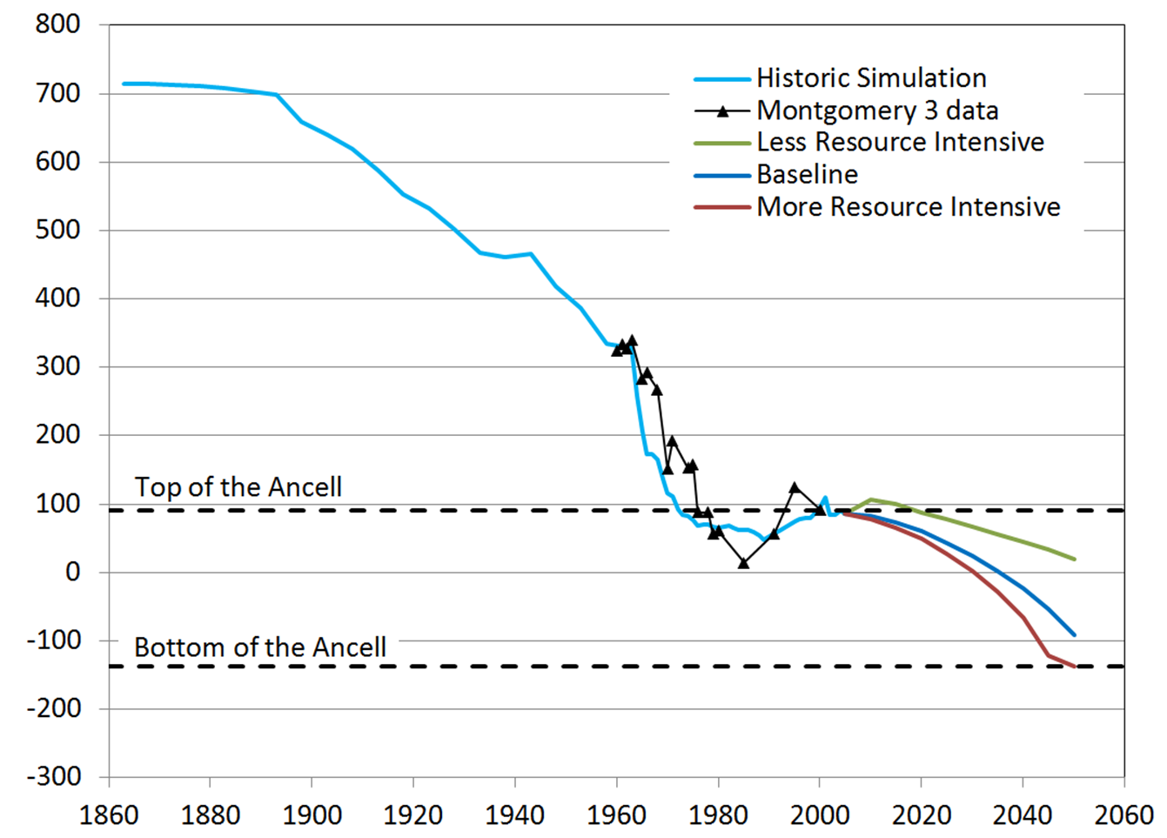
Transient Calibration

Slide 18
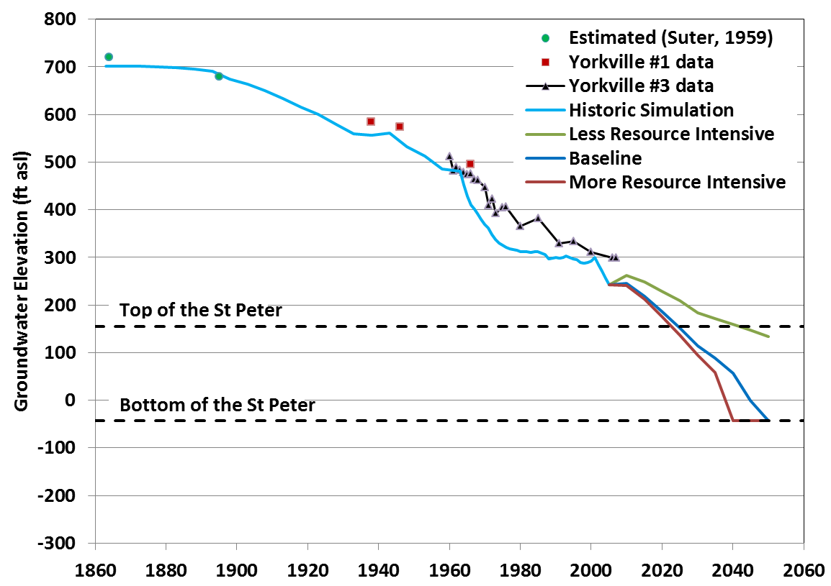
Northeastern Illinois Model
Transient Calibration and Projected Water Levels to 2050

Slide 20
Change in mean, absolute mean, and root mean square error through time for the IGWFM

Slide 21
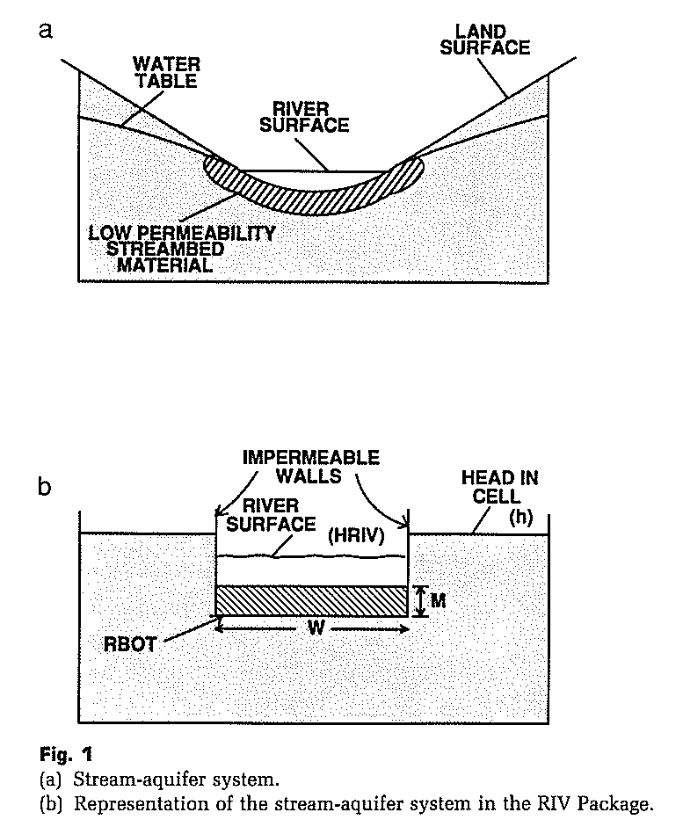
River Boundary
McDonald and Harbaugh (1988)

Slide 22
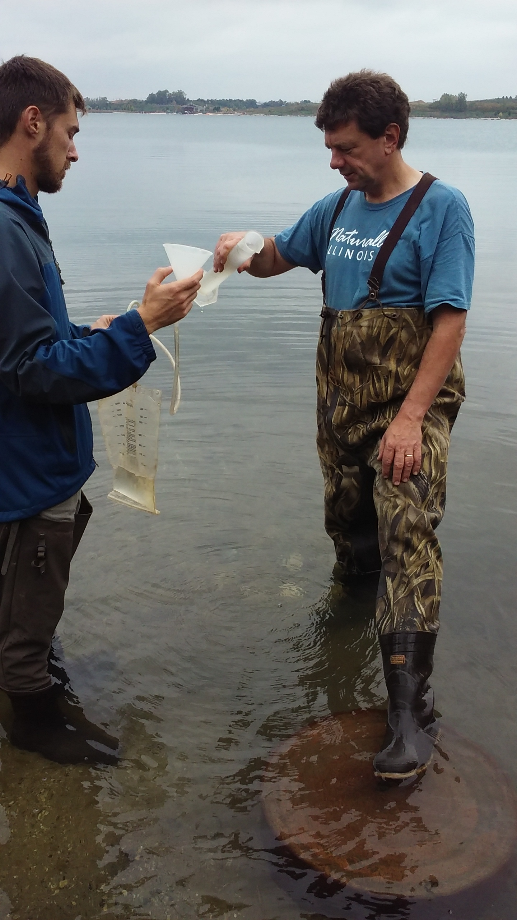
Collecting seepage data to confirm model fluxes

